Slide 1
Building knowledge graphs in DIG
Pedro Szekely and Craig Knoblock University of Southern California
Information Sciences Institute
dig.isi.edu

Slide 2






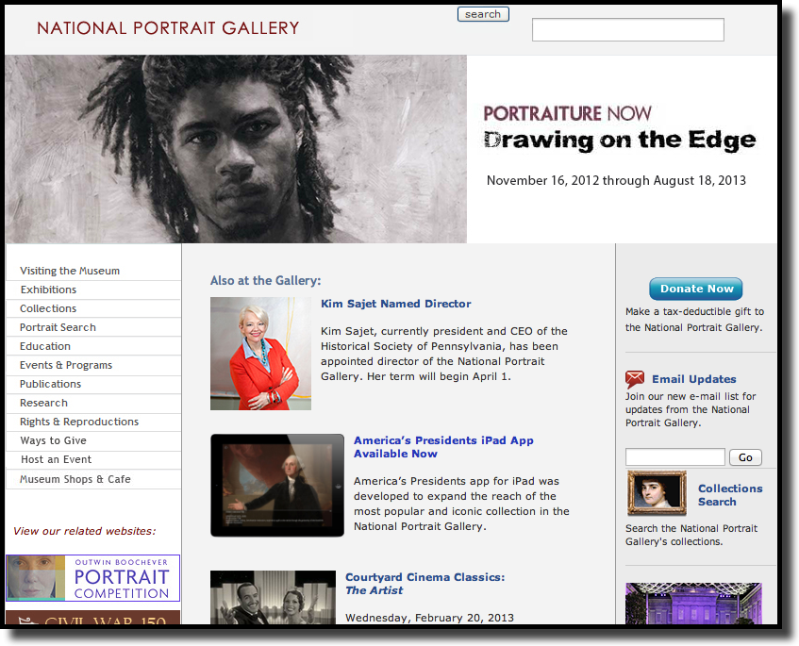
Goal
raw  messy  disconnected
clean  organized  linked
hard to query, analyze & visualize
easy to query, analyze & visualize

Slide 3
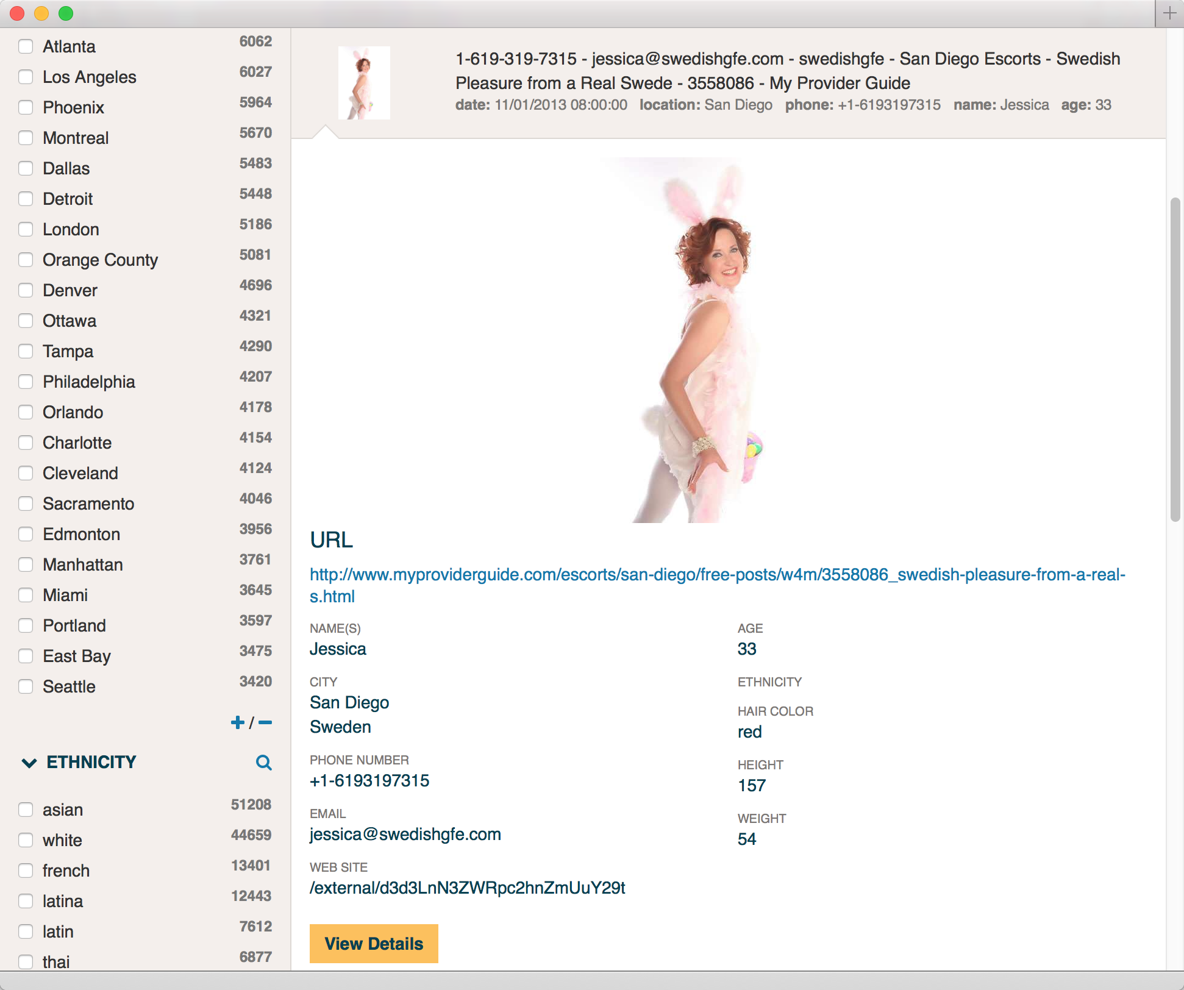
Use Case: Human Trafficking
raw  messy  disconnected
clean  organized  linked
hard to query, analyze & visualize
easy to query, analyze & visualize

Slide 4

Use Case: Human Trafficking
100 million pages
~ 100 Web sites
help victims
prosecute traffickers

Slide 5
Salient Statistics on Human Trafficking
Profits per Year: $32 Billion
Average Age of Entry To Prostitution in the US: 14
PIMP’s Profit Per Victim Per Year: $150,000
Advertising Budget On the Web: $45 Million

Slide 6


Task: Tracking the Victim’s Locations
> 100 million pages advertising adult services

Slide 7
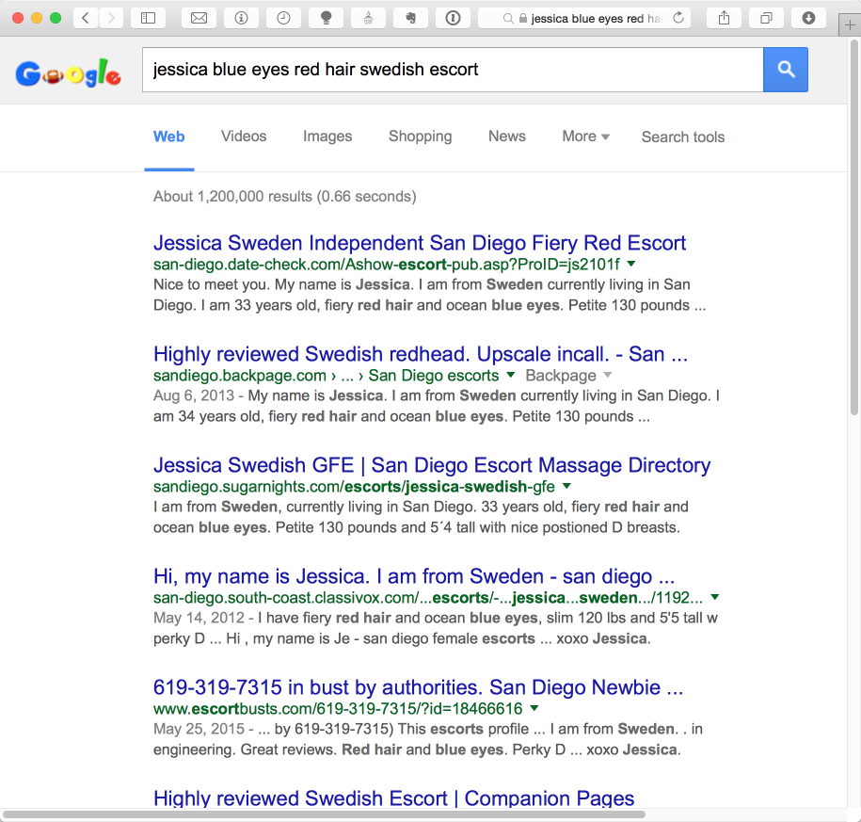
Example: Investigating a Reported Victim
San Diego, where else?

Slide 8
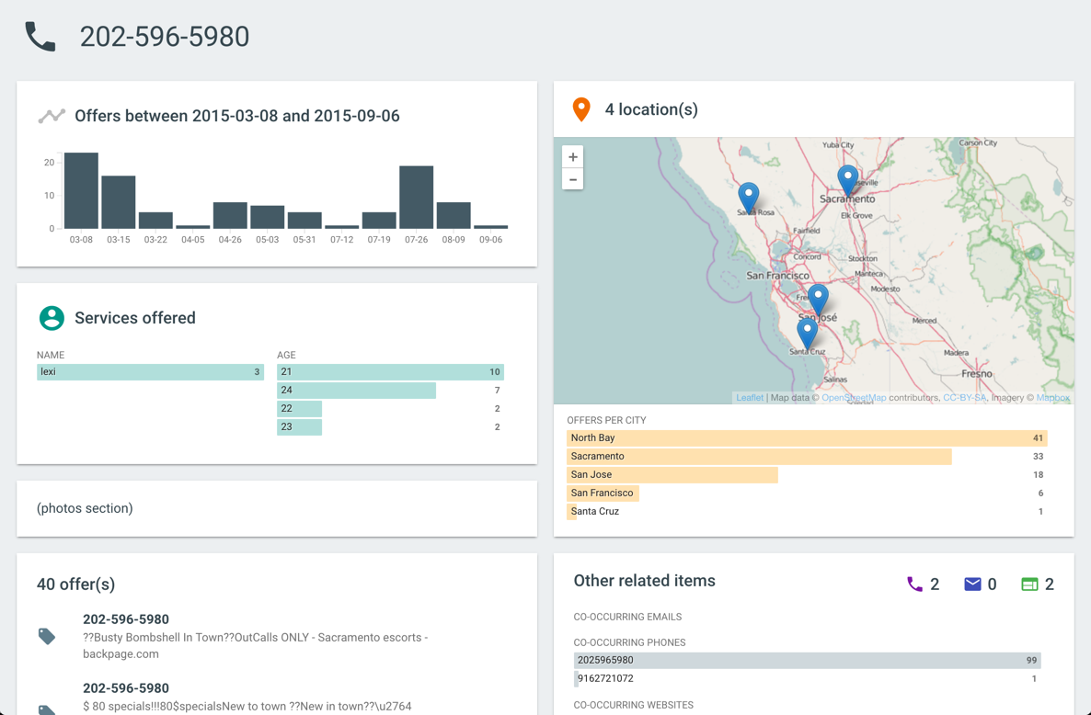
DIG Interface: Find the locations where a potential victim was advertised

Slide 9
Steps To Build a DIG
Data Acquisition
Data Acquisition
Feature Extraction
Feature
Alignment
Entity
Resolution
Graph
Construction
User
Interface

Slide 10
Data Acquisition
downloading relevant data
batch  real-time
Web pages Web service  database  CSV  Excel  XML  JSON

Slide 11
Steps To Build a DIG
Data Acquisition
Feature Extraction
Feature
Alignment
Entity
Resolution
Graph
Construction
User
Interface

Slide 12
Feature Extraction
from raw sources to structured data
trainable text extractors
extraction from structured Web pages
image features
PDF extractor

Slide 13
Feature Extraction from Text
“YOU don't wanna miss out on ME :) Perfect lil booty Green eyes Long curly black hair Im a Irish, Armenian and Filipino mixed princess :) ❤ Kim ❤ 7○7~7two7~7four77 ❤ HH 80 roses ❤ Hour 120 roses ❤ 15 mins 60 roses”
name: Kim
eye-color: green
hair-color: black
phone: 707-727-7477
rate: $60/15min
$80/30min
$120/60min

Slide 14
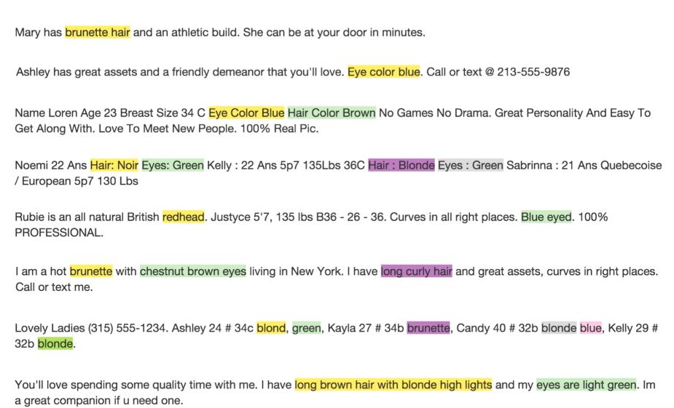
20 Examples

Slide 15

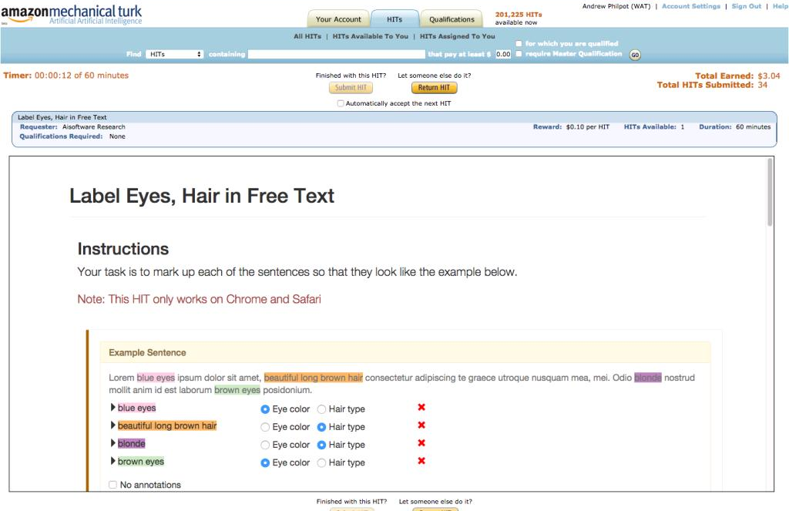
1,000’s of Tasks (2 Cents/Sentence)

Slide 16
Performance of CRF Extractors
Eyes
Hair

Slide 17
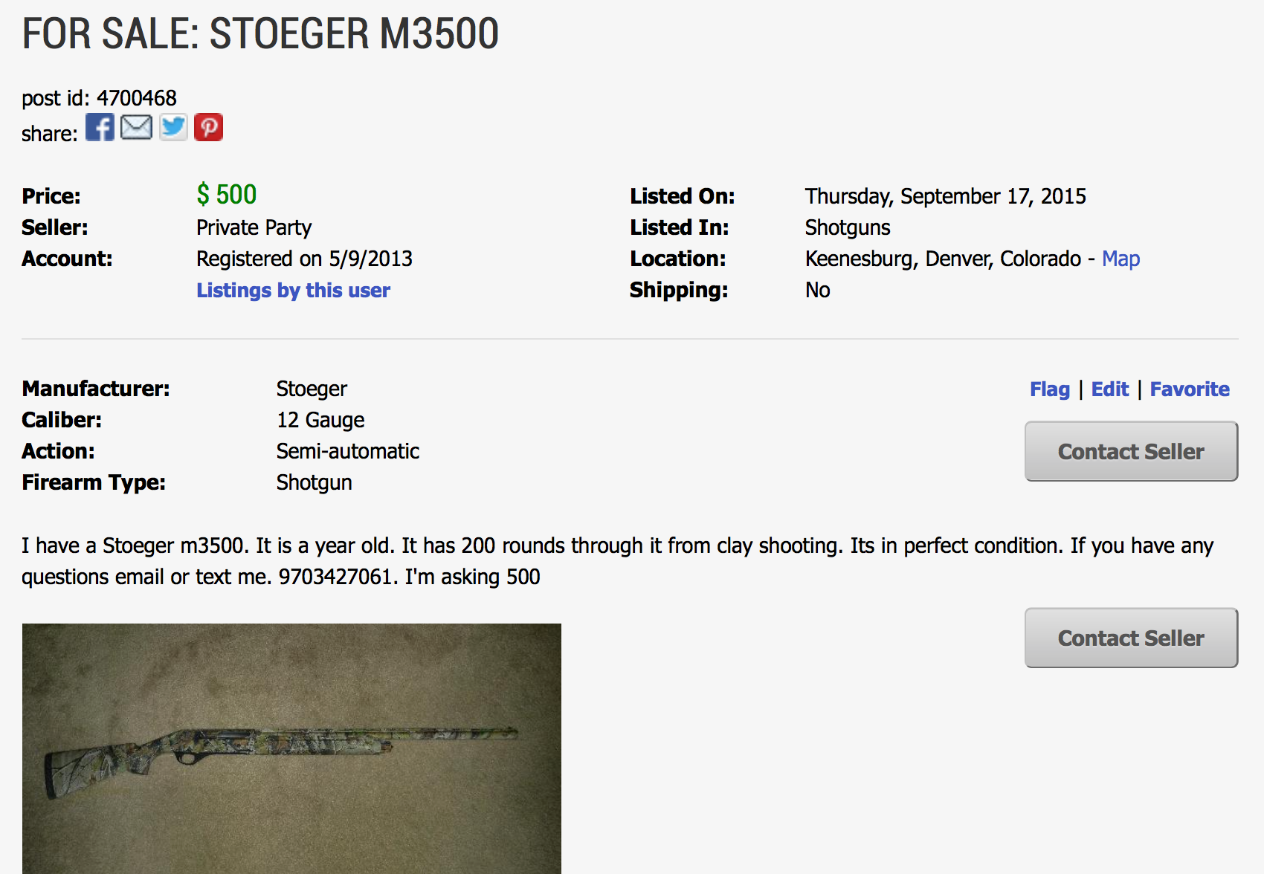
Structured Extraction

Slide 18
Automated Extraction
Infer
Extractor
Infer
Extractor
Classify by
Templates
Infer
Extractor
Infer
Extractor
input:
a pile of pages
pages clustered
by template
extractor

Slide 19
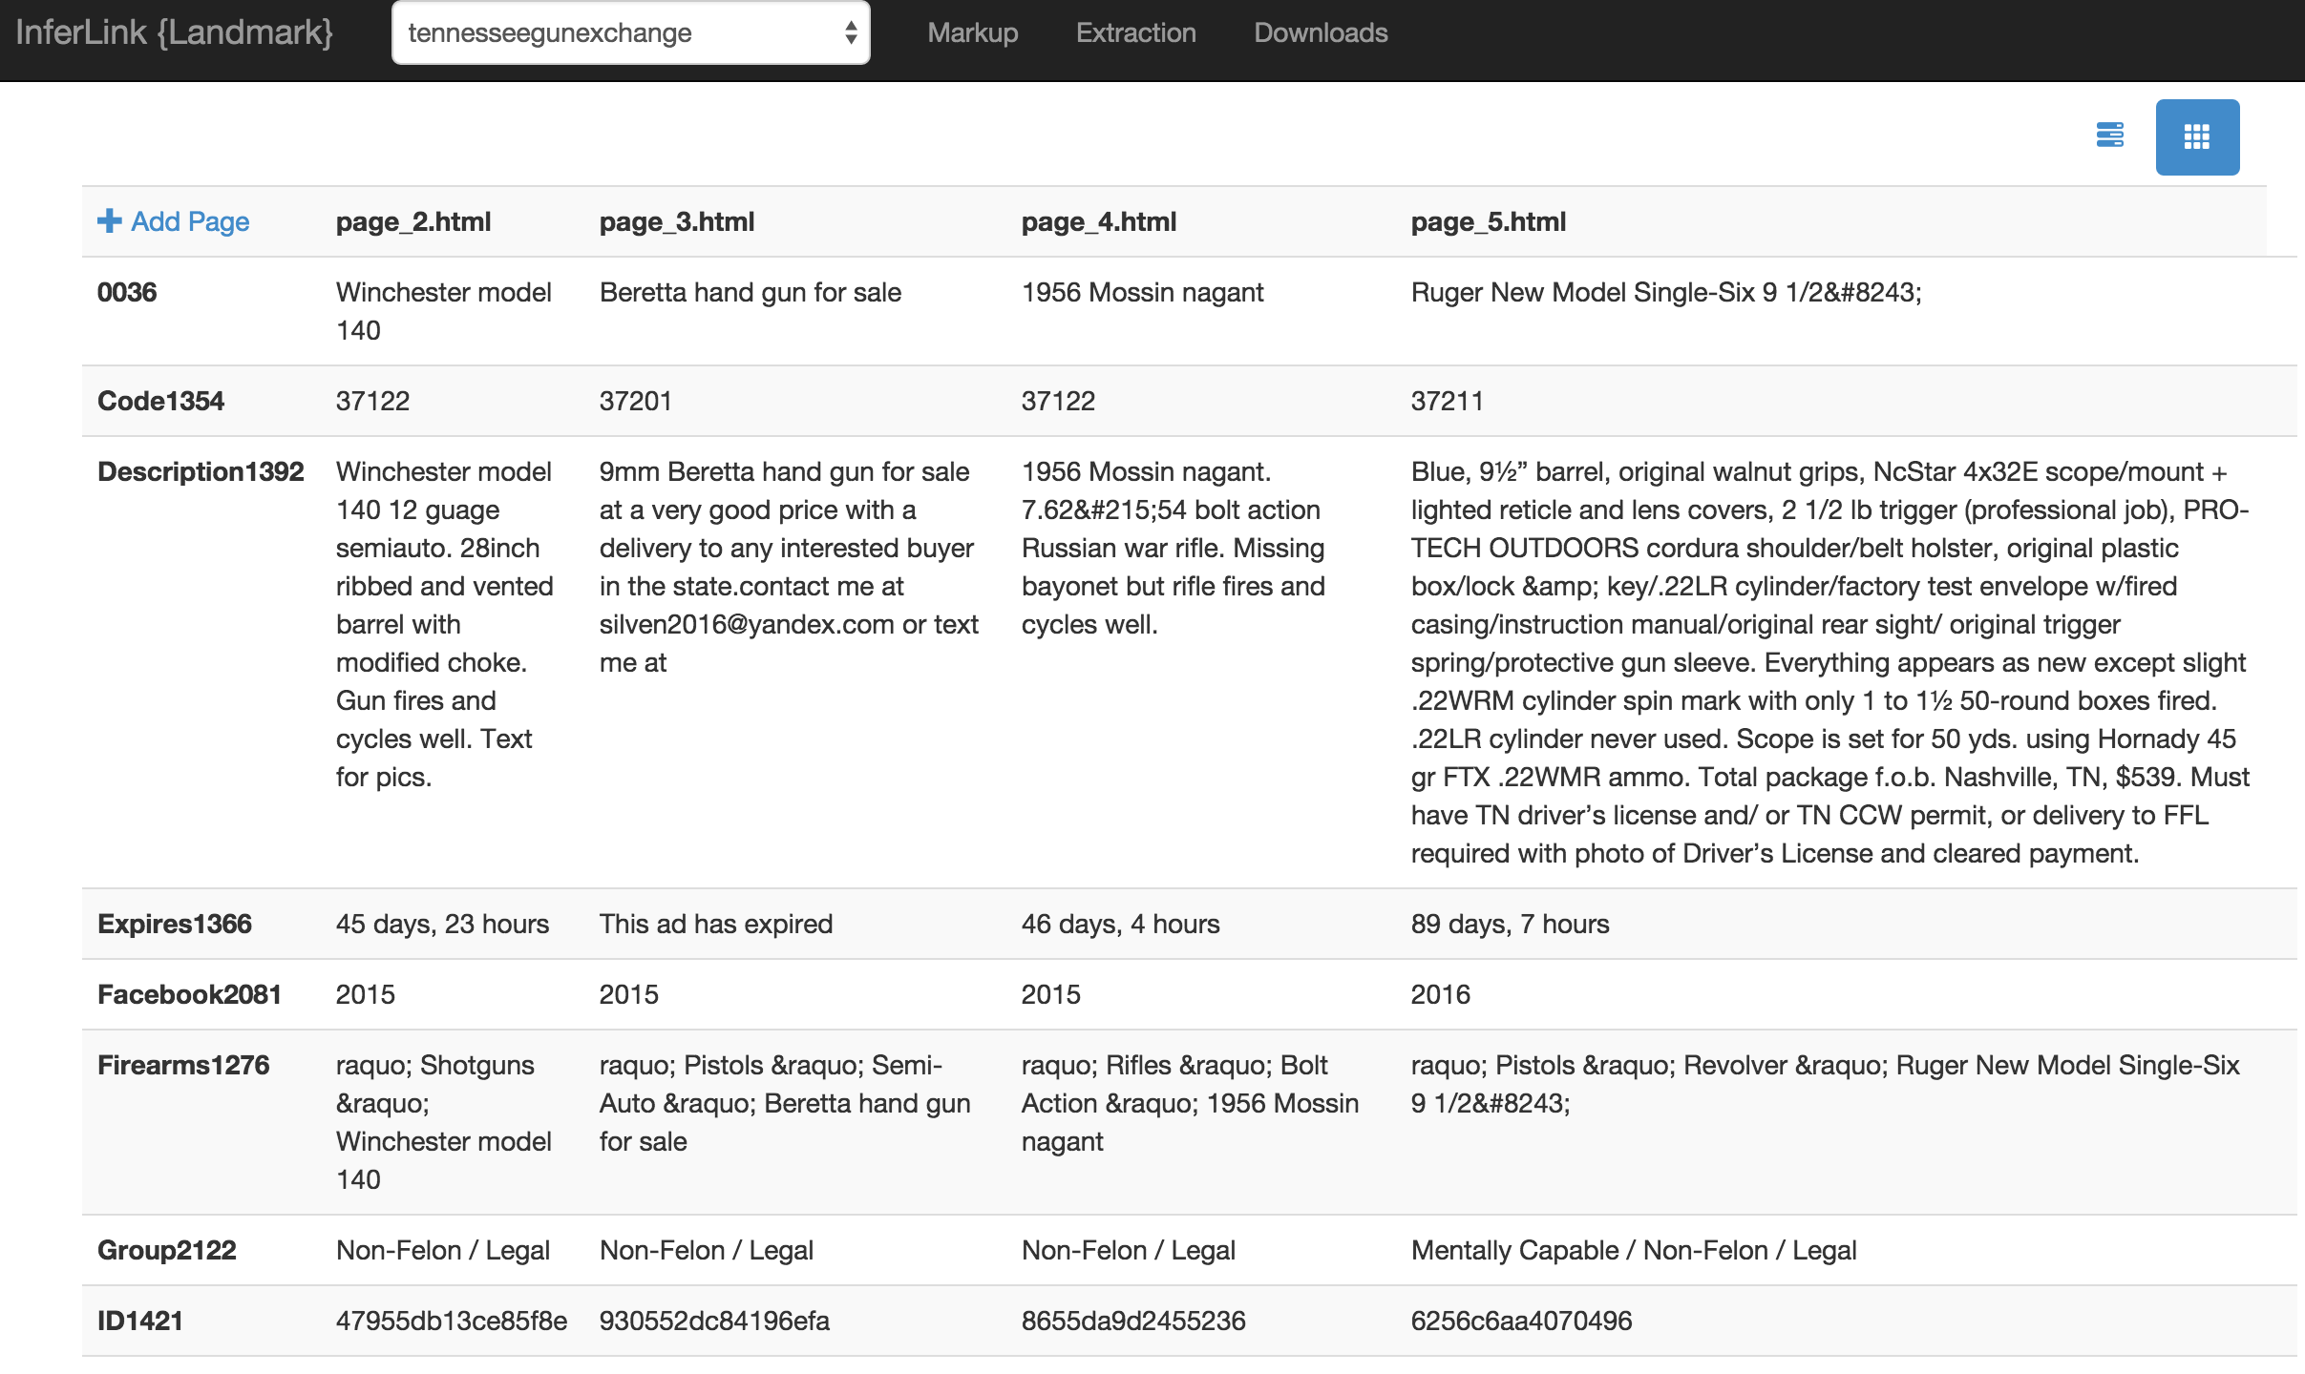
Unsupervised Extraction Tool

Slide 20
Extraction Evaluation
10 websites, 5 pages each
fields
 | Title | Desc | Seller | Date | Price | Loc | Cat | Member Since | Expires | Views | ID
Perfect | 1.0 (50/50) | .76 (37/49) | .95 (40/42) | .83 (40/48) | .87 (39/45) | .51 (23/45) | .68 (34/50) | 1.0 (35/35) | .52 (15/29) | .76 (19/25) | .97 (35/36)
Pretty Good | 1.0 (50/50) | .98 (48/49) | .95 (40/42) | .83 (40/48) | .98 (44/45) | .84 (38/45) | .88 (44/50) | 1.0 (35/35) | .55 (16/29) | 1.0 (25/25) | 1.0 (36/36)

Slide 21
Steps To Build a DIG
Data Acquisition
Feature Extraction
Feature
Alignment
Entity
Resolution
Graph
Construction
User
Interface

Slide 22
Feature Alignment
from multiple schemas to a common domain schema
Multiple Schemas
CSV, Excel
Database tables
Web services
Extractors
Nomenclature
Spelling

Slide 23
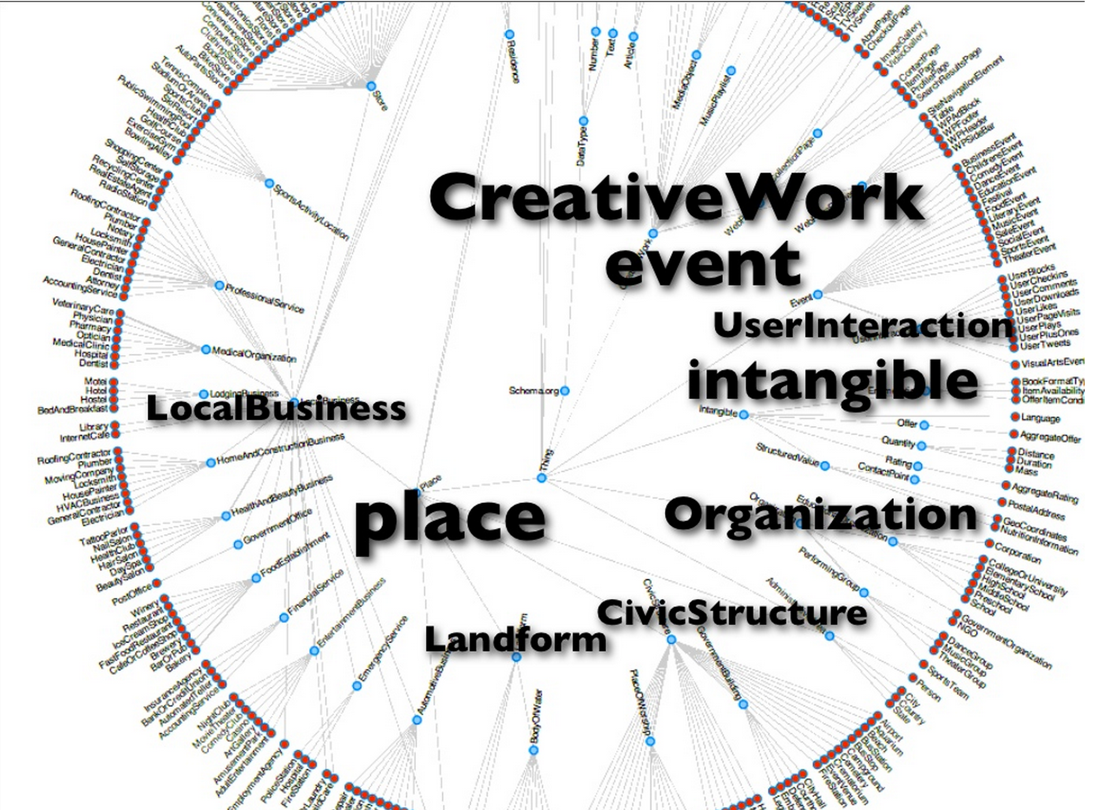
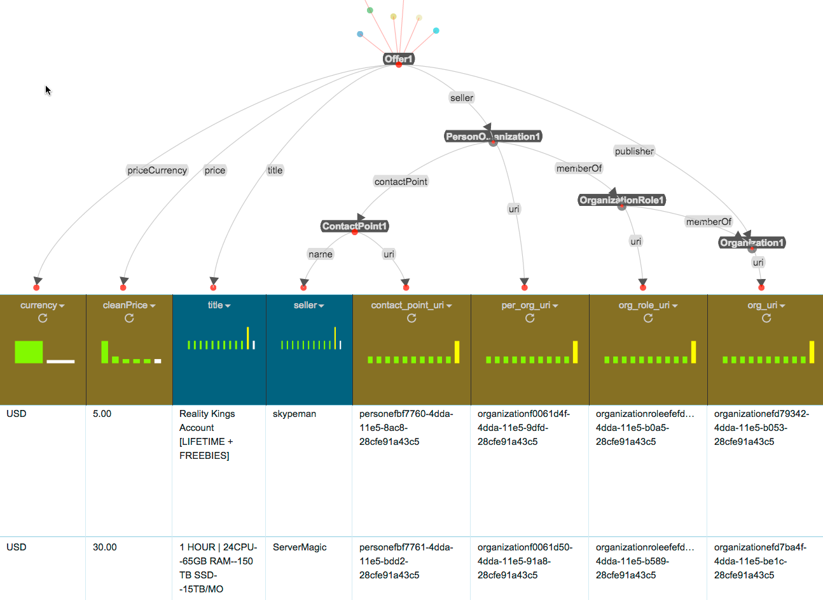

Karma: Mapping Data to Ontologies
Relational
Sources
Hierarchical Sources
Services
Mapping to Ontology
Karma
Schema.org
Data
{ JSON-LD }
karma.isi.edu
Notes:
Karma offers suggestions on how to do the mapping

Slide 24
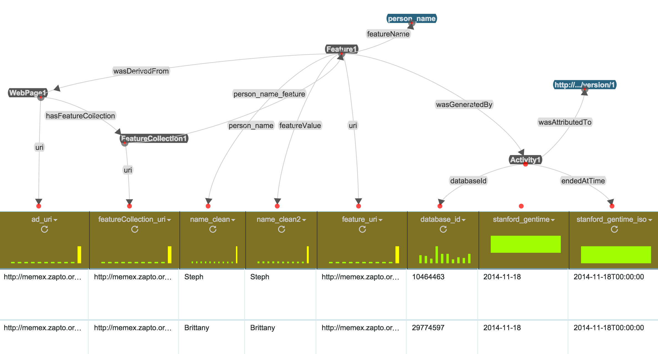
Karma Solves Feature Alignment
Domain Schema
Provenance
took ~30 minutes to align the output of the Stanford name extractor

Slide 25
Feature Alignment Statistics
5 contractors provided data
~ 15 datasets
> 30 Karma models
> 200 million records
1 hour processing in 20 node Hadoop cluster

Slide 26
Steps To Build a DIG
Data Acquisition
Feature Extraction
Feature
Alignment
Entity
Resolution
Graph
Construction
User
Interface

Slide 27
Entity Resolution
merging records that refer to the same entity
currently working on techniques to address
missing data
incorrect data
scale (~50 million records)

Slide 28
Entity Resolutuion on Strong Attributes
Notes:
Simplest kind of linking we do – linking based on strong, explicit attributes (phones, emails, websites, etc.)
So person-1 and person-2 might be the same person … but can we find more attributes to improve our confidence …

Slide 29
Linking Using Text Similarity
E M I L Y SEXY. ** wHiTe/lATin girl ** bUsTy SWEET. LoTs Of fUn. Call Me. O_U_T_C___A___L_L_S
L A Y L A SEXY. ** wHiTe girl ** bUsTy SWEET. LoTs Of fUn. Call Me. O____U____T____C___A___L____L____S
L I L A SEXY. ** WhiTe girl ** bUsTy SWEET. LoTs Of fUn. Call Me. O_U_T_C___A___L_L_S
Notes:
Estimating text similarity is challenging – here we are emphasizing stylometric similarity; map->n-grams->jacquard similarity

Slide 30
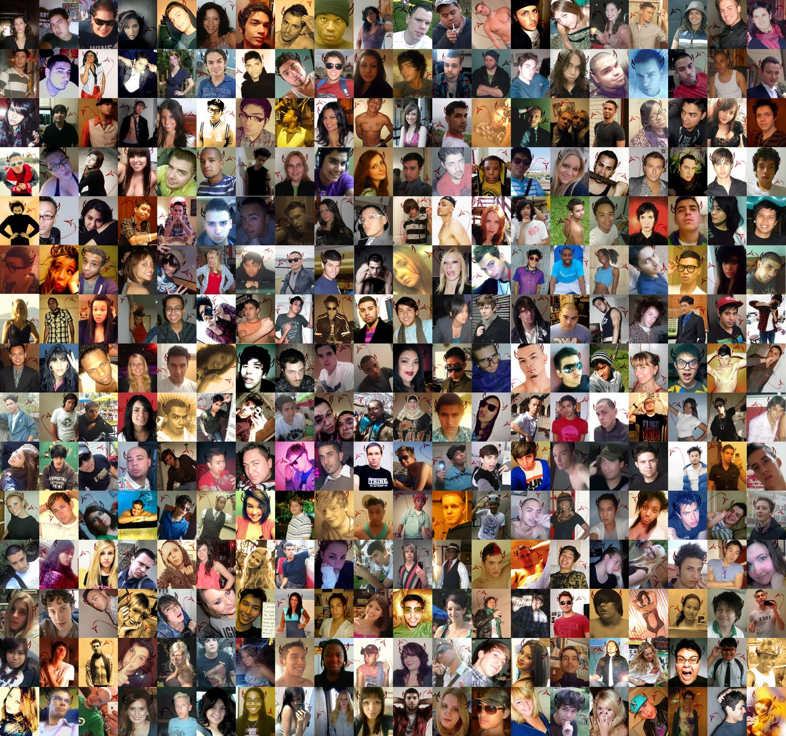
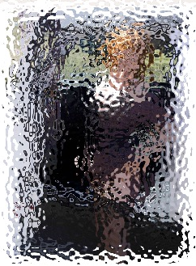
Linking Using Image Similarity
100 Million Images Technology: Deep Learning
Notes:
Clever scheme for storing pair-wise similarities in a database that can be updated incrementally (so we can bypass hashing that leverages elastic search w/lucene)

Slide 31
Unsupervised Collective Entity Resolution
same victim
same Trafficker
Notes:
Why is linking significant in this domain? Slide shows why.

Slide 32
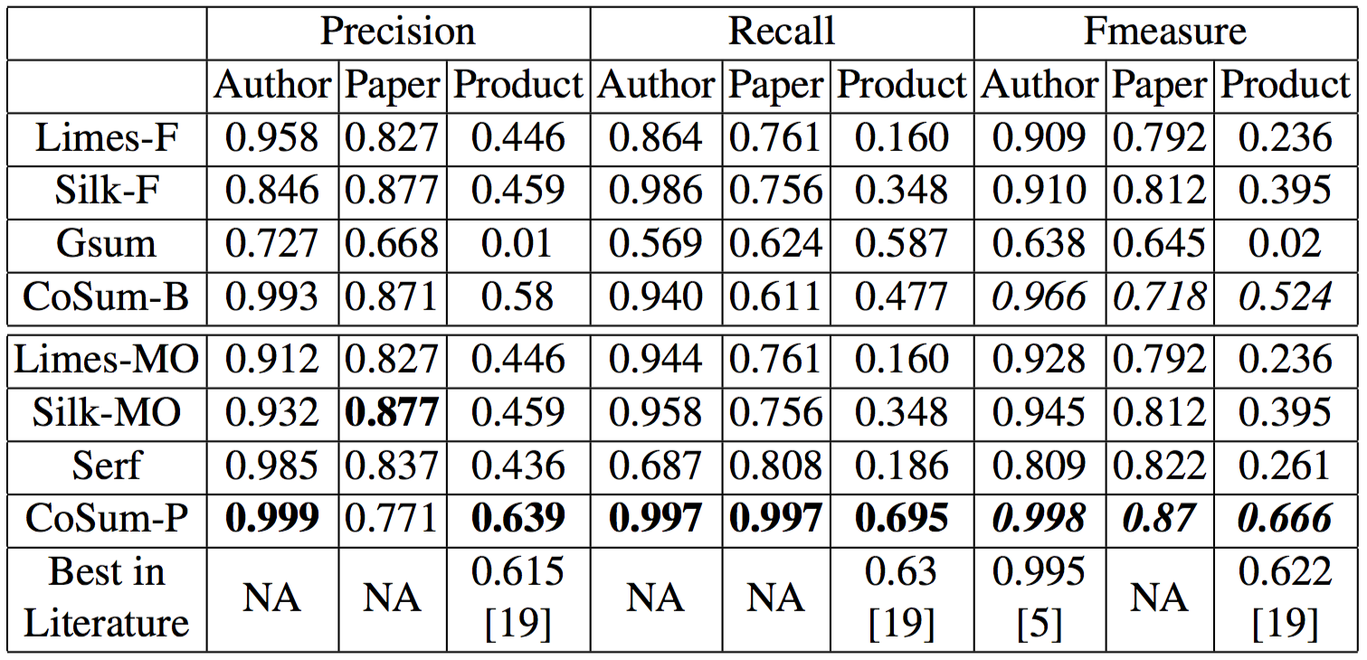
Unsupervised Collective Entity Resolution

Slide 33
Steps To Build a DIG
Data Acquisition
Feature Extraction
Feature
Alignment
Entity
Resolution
Graph
Construction
User
Interface

Slide 34
Graph Construction
assembling the data for efficient query & analysis
ElasticSearch: scalable, efficient query
graph databases: network analytics
NoSQL: scalable analytics
bulk loading: massive data imports
real-time updates: live, changing data

Slide 35

Elastic Search Data Model
Adult
Service
Offer
Person
Phone
Web
Page
Notes:
There is some clever tricks
We produce json documents rooted on the classes we care about .. Contain enough of the graph-neighborhood so that keyword queries can work so that I can search for an adultservice using a phone number even though the phone number is really part of the seller. Or search all offers that have the same phone number. Basically copying over some content.

Slide 36
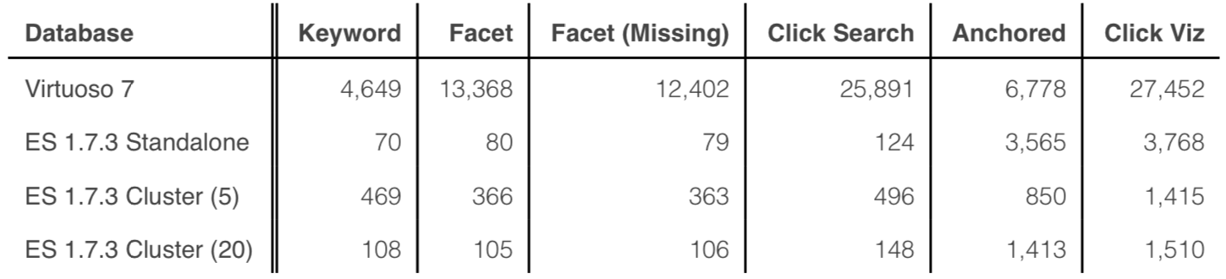
Indexing for High Performance Knowledge Graph Queries
Avg. Query Times in Milliseconds
Single User Query Load
1.2 billion triples
State of the Art Graph Database (RDF)
DIG indexing deployed in ElasticSearch

Slide 37
Steps To Build a DIG
Data Acquisition
Feature Extraction
Feature
Alignment
Entity
Resolution
Graph
Construction
User
Interface

Slide 38
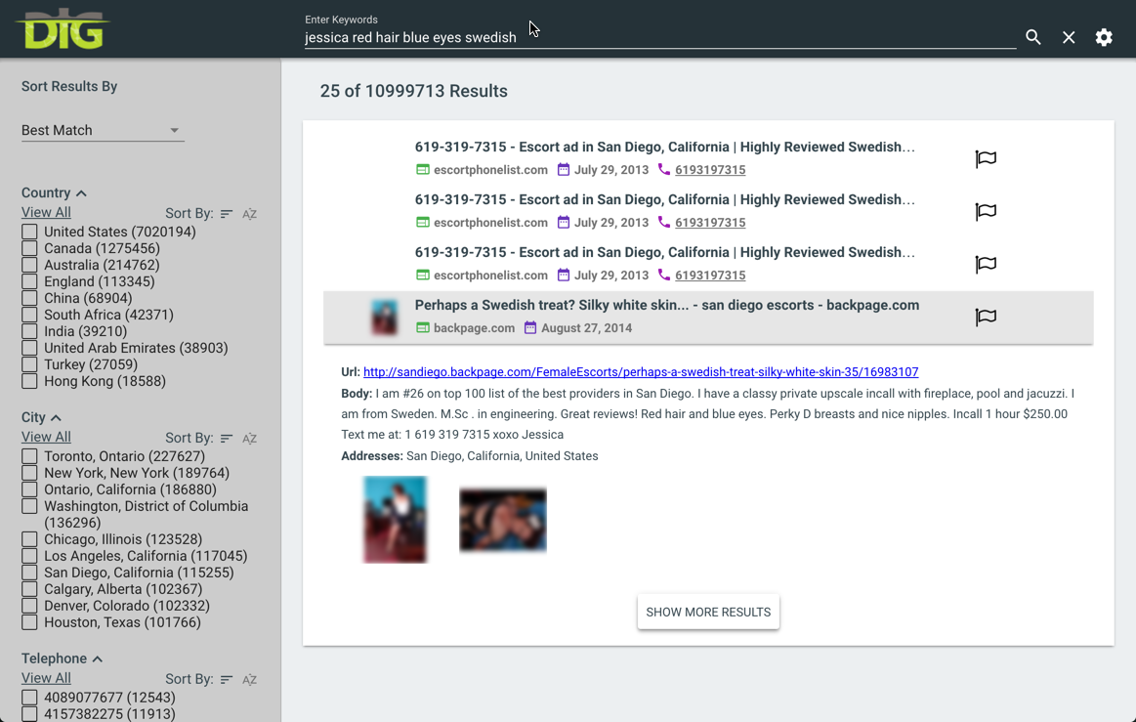

Slide 39
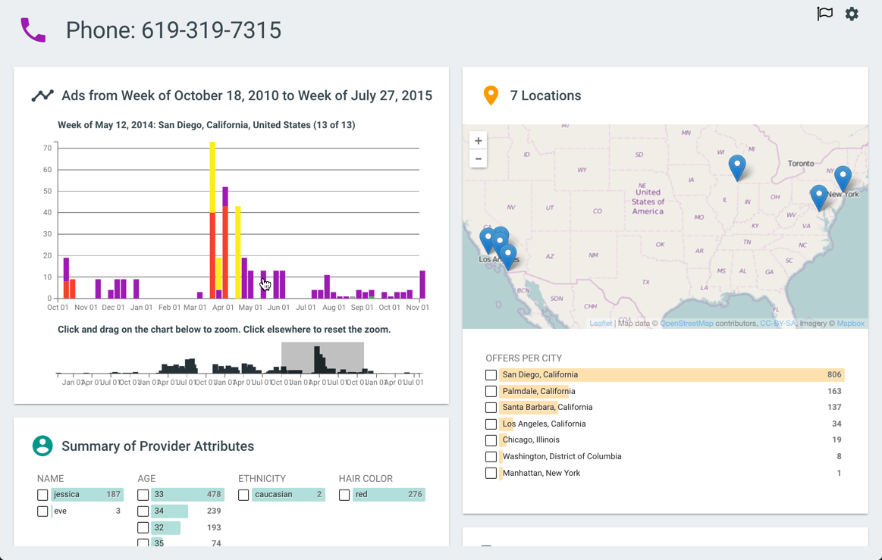

Slide 40
DIG Deployment for Human Trafficking
100 million Web pages
Live updates (~5,000 pages/hour)
ElasticSearch database (7 nodes)
Hadoop workflows (20 nodes)
District Attorney
Law Enforcement
NGOs

Slide 41

Deployed to 6
Law Enforcement Agencies and Successfully Used to Prosecute Traffickers

Slide 42
DIG Applications
Human Trafficking
large, real users
Material Science Research
70,000 paper abstracts (built in 1 week)
Arms Trafficking
Identify illegal sales
Patent Trolls
Identify patent trolls
Cyber Attacks
Predict cyber attacks from dark web data

Slide 43
Conclusions
Complete tool-chain to build domain-specific knowledge graphs
Integrates heterogeneous data: web pages, databases, CSV, web APIs, images, etc.
Scales to ~100 million pages, ~3 billion facts
Deployed to law enforcement

Slide 44
Questions?
dig.isi.edu
Open Source, Apache 2 License

